Slide 1

DatA and web mining
Application of data mining tools + Techniques CA
Dermot Madsen – 10522567
Ciaran Finnegan - 10524150
Wine Quality Dataset

Slide 2
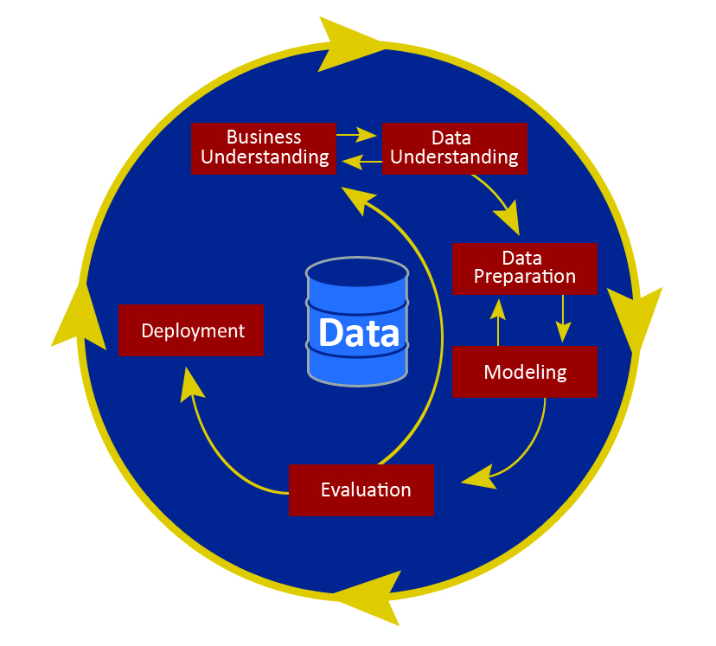
CRISP-DM

Slide 3

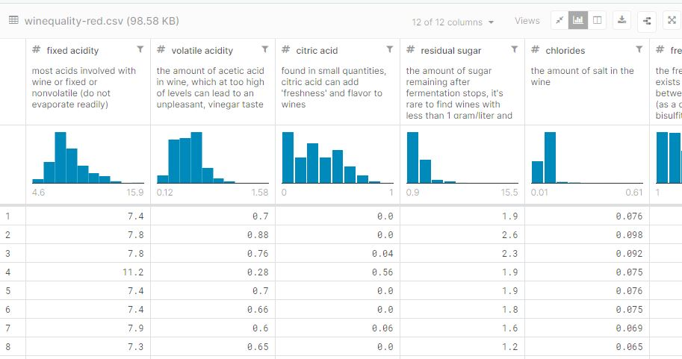

CRISP-DM : Business Understanding
Build a data driven predictive model to help staff recommend wine to customers.
Based on chemical data, not marketing or financial.

Slide 4
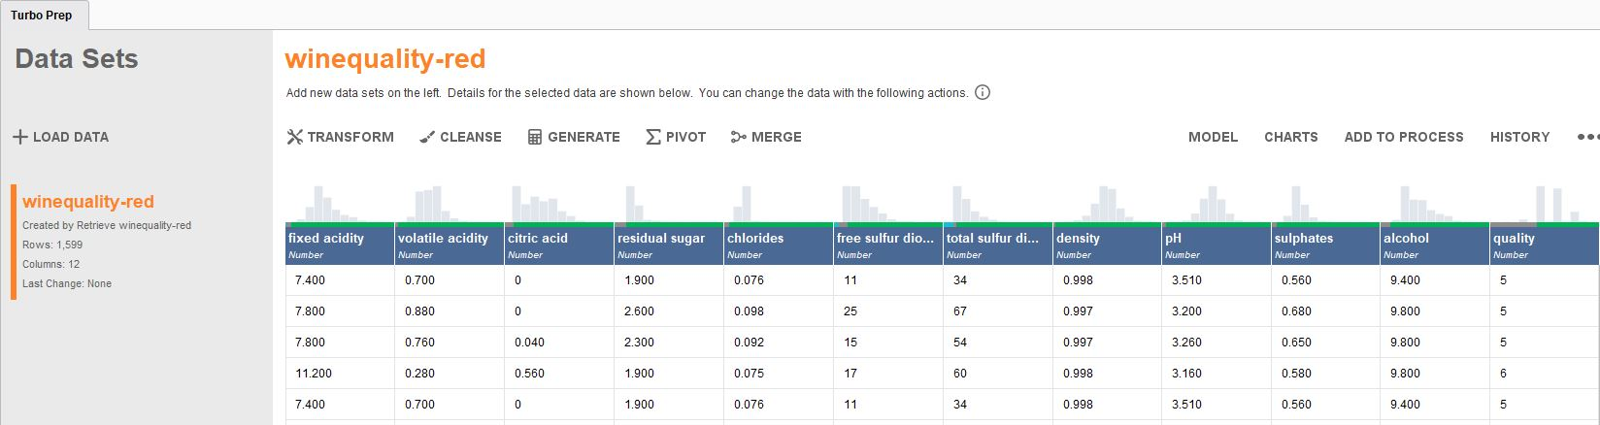
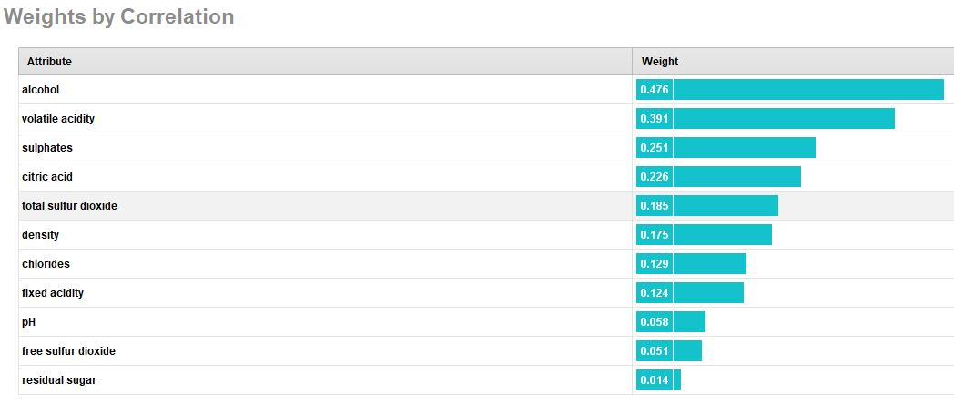
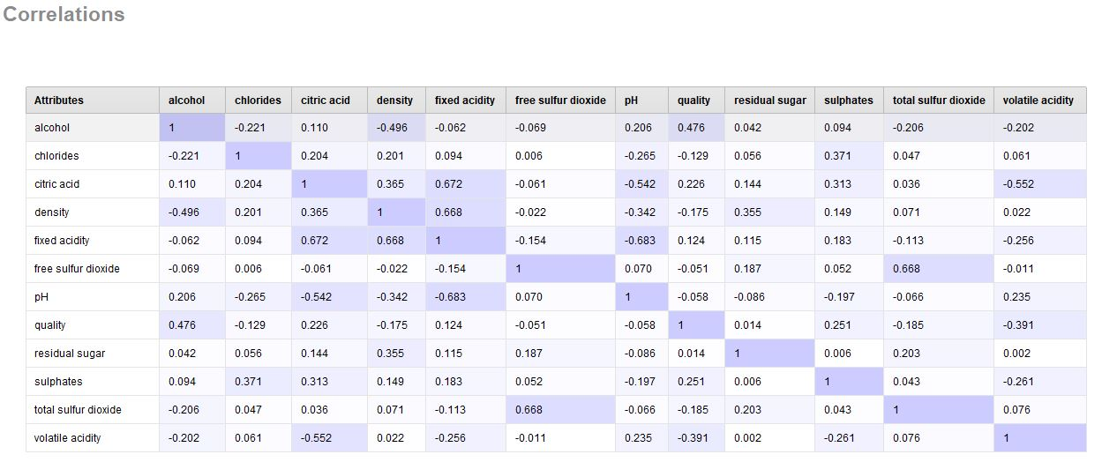
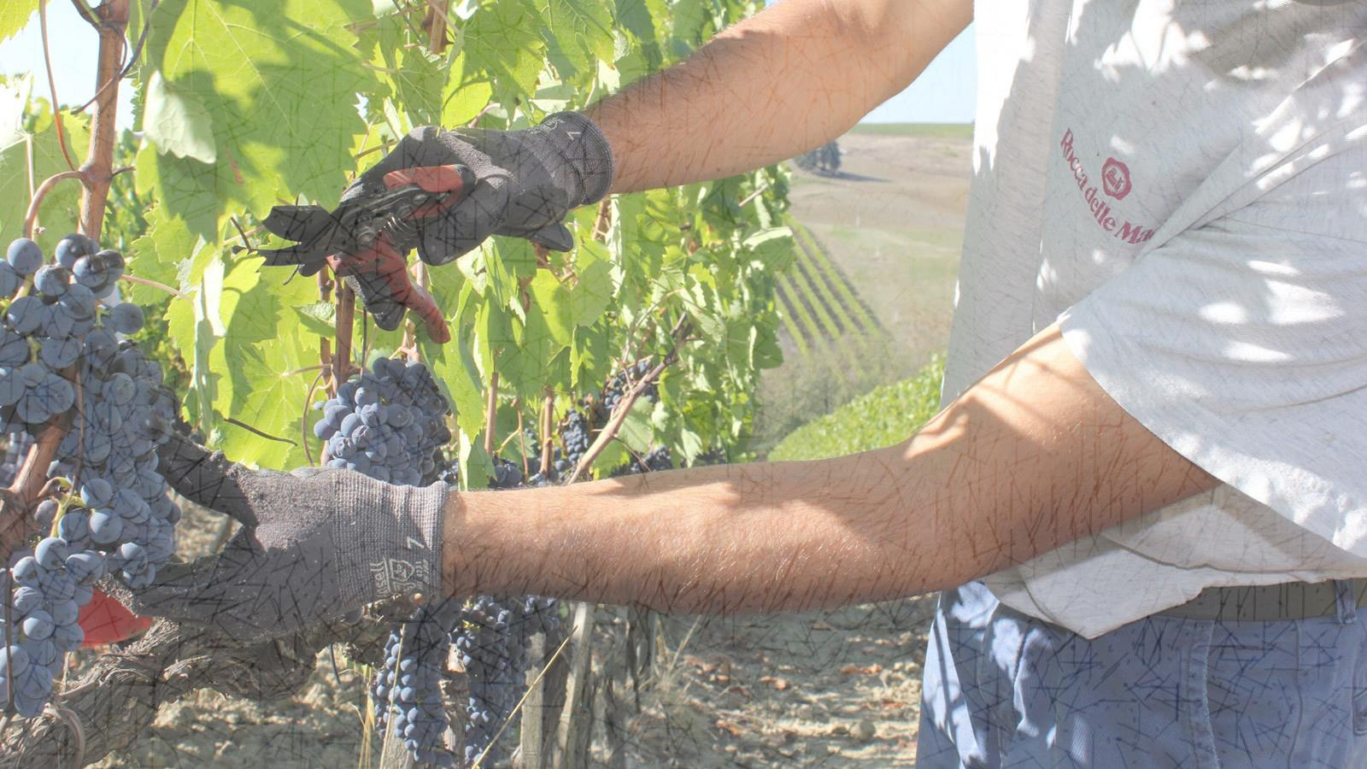
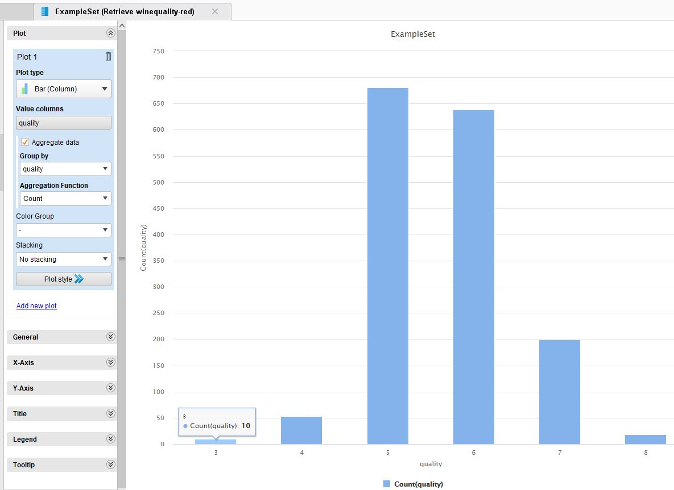
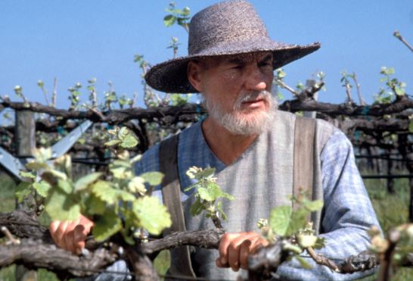
CRISP-DM : Data Understanding
Exploring the data – Kaggle Wine Quality dataset.
1600 rows x 12 columns.
‘Clean’ dataset – no missing rows, or ‘bad’ data.
Attributes vary in importance for ‘quality’.
Some correlation between features. Options to ‘prune’ feature list.
Dataset out of balance – few very poor or high quality wine entries.

Slide 5
CRISP-DM : Data Preparation

Slide 6
CRISP-DM : Modelling

Slide 7
CRISP-DM : Evaluation

Slide 8
CRISP-DM : deployment

Slide 9
Learnings

Slide 10
conclusion

Slide 11
